Slide 1
Communication for Sustainability
Lesson 02: Framing

Slide 2
Where are we?
Episode 1: Key concepts of communication
Episode 2: Framing
Episode 3: Narratives & Storytelling
Episode 4: Cultures of Sustainability

Slide 3
Learning outcomes
Learning outcome 1:
Describe the diverse nature of contemporary practices of sustainability communication on an individual, organizational and societal level, the relationship of strategic communication practices to other public communication practices, the role of stakeholders and publics and the communication practitioners in and outside of organizations (corporate, NGO, political and educational institutions etc.)
Learning outcome 2:
Develop comprehensive and well-founded knowledge in sustainability communication as field of study, an understanding of how other disciplines relate to the field and an international perspective on the field.
Learning outcome 3:
Understand the key elements of communication theories, strategies and tactics, and, thus, the character and operationalization of best practice sustainability communication planning frameworks.
Learning outcome 4:
Advance your understanding of social and civic responsibility and develop an appreciation of the philosophical and social context of sustainability communication. Advance your knowledge and respect of ethics and ethical standards in relation to communication of, about and for sustainability.
Learning outcome 5:
Anticipate and Interpret current issues and challenges of a world in transformation and social change. Develop a deep understanding of and skills to create change, develop advocacy, leadership and authorship in and for sustainability communication.

Slide 4
Overview
Definitions
Frames as linguistic devices
Framing examples
Framing for the future?
Notes:
Dimensions: 3 Säulen
What is communicated?
Frames -> What are the „arguments“?! What is the sub-text?

Slide 5
Framing
Hidden patterns = FRAMES
Process of FRAMING
Source: Picture by Fæ on commons.wikimedia.org
Notes:
Deutungsmuster
Allgemeiner: Perspektive auf ein Thema
Konkreter: Definition von Problemen/Lösungen
Kognitiv: Schemata der Informationsverarbeitung
Kulturell: Deutungen, die in einem kulturellen Kontext Resonanz finden
Frames sind bei uns im Kopf, auch z.B. bei Journalisten. Sind kulturell bedingt...

Slide 6
A. Definitions
Framing
a dynamic, circumstantially-bound process of opinion formation in which the prevailing modes of presentation in elite rhetoric and news media coverage shape mass opinion
Framing effects refer to behavioural or attitudinal outcomes that are not due to differences in what is being communicated, but rather to variations in how a given piece of information is being presented (or framed) in public discourse.
Entman (1996): „to frame means to select some aspects of a perceived reality and make them more salient in a communication text, in such a way as to promote a particular problem definition, causal interpretation, moral evaluation and/or treatment recommendation“

Slide 7
A. Definitions
Framing
Episodic framing the dominant form of broadcast news coverage – issues depicted as particular instances: homeless person, single mother, laid off worker as symptomatic of poverty, particular criminal acts instead of overall trends in the level of crime (Iyengar, 1991)
Thematic framing embeds issues in some general or societal context – historical trends in unemployment or poverty; news accompanied by expert analysis

Slide 8
A. Definitions
Frames
“The frame suggests what the controversy is about, the essence of the issue” (Gamson & Modigliani 1989, in Vreese: 27)
Frames are ..interpretative packages that give meaning to an issue (Gamson & Modigliani, 1989: 3)
Framing involves implicit information between the lines, the frame provides a context for the interpretation of a news message

Slide 9
A. Definitions
Frames
Frames are perceptual experiences which activate some structures that we‘ve acquired in the course of previous experiences
„frames are persistent patterns of cognition, interpretation, and presentation, of selection, emphasis, and exclusion, by which symbol-handlers routinely organize discourse“ (Gitlin, 1980)
„frames are organizing principles that are socially shared and persistent over time, that work symbolically to meaningfully structure the social world“ (Reese et al., 2001)

Slide 10
B. Frames as language device
Frames include...
Metaphor: To frame a conceptual idea through comparison to something else.
Stories (myths, legends): To frame a topic via narrative in a vivid and memorable way.
Tradition (rituals, ceremonies): Cultural mores that imbue significance in the mundane, closely tied to artifacts.
Slogan, jargon, catchphrase: To frame an object with a catchy phrase to make it more memorable and relate-able.
Artifact: Objects with intrinsic symbolic value – a visual/cultural phenomenon that holds more meaning than the object itself.
Contrast: To describe an object in terms of what it is not.
Spin: to present a concept in such a ways as to convey a value judgement (positive or negative) that might not be immediately apparent; to create an inherent bias by definition. (Fairhurst & Sarr, 1996)

Slide 11
B. Frames as language device
Metaphors
Metaphor
Metaphor
Metaphor
Frames
Masterframe
Issue specific frame: diagnostic, prognostic, motivational
Claim
Notes:
Claims:
Comaparbel with „Scripts“ – just prepackaged sequences of causal chains …
some causal chains are used so often that we do not spell out enough of their details for an understander to make the connections directly.
Scripts are a kind of ey to connecting events together that do not connect by their superficial features bt rather by the rememberance of their having been connected before (Schank, Robert, 1980; Language and Memory)

Slide 12
C. Examples
Topic: Asylum seekers and undocumented immigrants
Claim: Due to the war, we experience a wave of refugees, this will be one of the major challenges in Europe in the next years.
Alternative frames (van Gorp 2007):
Misgovernment frame
Intruder/strangers frame
Our hospitality frame
The innocent victim frame
The donor/support frame
The “not in my backyard” frame
Metaphor

Slide 13
C. Examples
Metaphors
Metaphor
Metaphor
Metaphor
Frames
Masterframe
Issue specific frame: diagnostic, prognostic, motivational
Claim
ascribes a specific meaning
(cognitive) interpretation

Slide 14
C. Examples
Metaphors
Metaphor
Metaphor
Metaphor
Frames
Masterframe
Issue specific frames: diagnostic, prognostic, motivational
Claim
Problem definition
Causal interpretation
Moral evaluation
Treatment recommendation
(Entman, 1993)
ascribes a specific meaning
(cognitive) interpretation

Slide 15
C. Examples
Which keywords define a frame/identify a frame? (key word analysis)
Example: Wetland issues (Australia or USA) (frame mapping)
Conservation advocates
Natural
Property owner, advocates
Farmers, farm
River
Earth
Wildlfe, species
Conservation, protect
Habitat, ecosystem
Threatened
Research, rare
Bird, migratory, fish
Rights, oweners
Agriculture
Regulations, laws
Compensation
Business
Ranchers
private
Sources: private

Slide 16
C. Examples
Each frame forms an „interpretive package“ that makes sense of the issue and suggests a course of action
Pro-choice frame:
Women‘s rights
Fetus, embryo
Scientific evidence
Choice, freedom
Pro Life
Pro-life frame:
Baby‘s rights
Baby, unborn child, pre-born child
Moral, religion
Life, murder

Slide 17
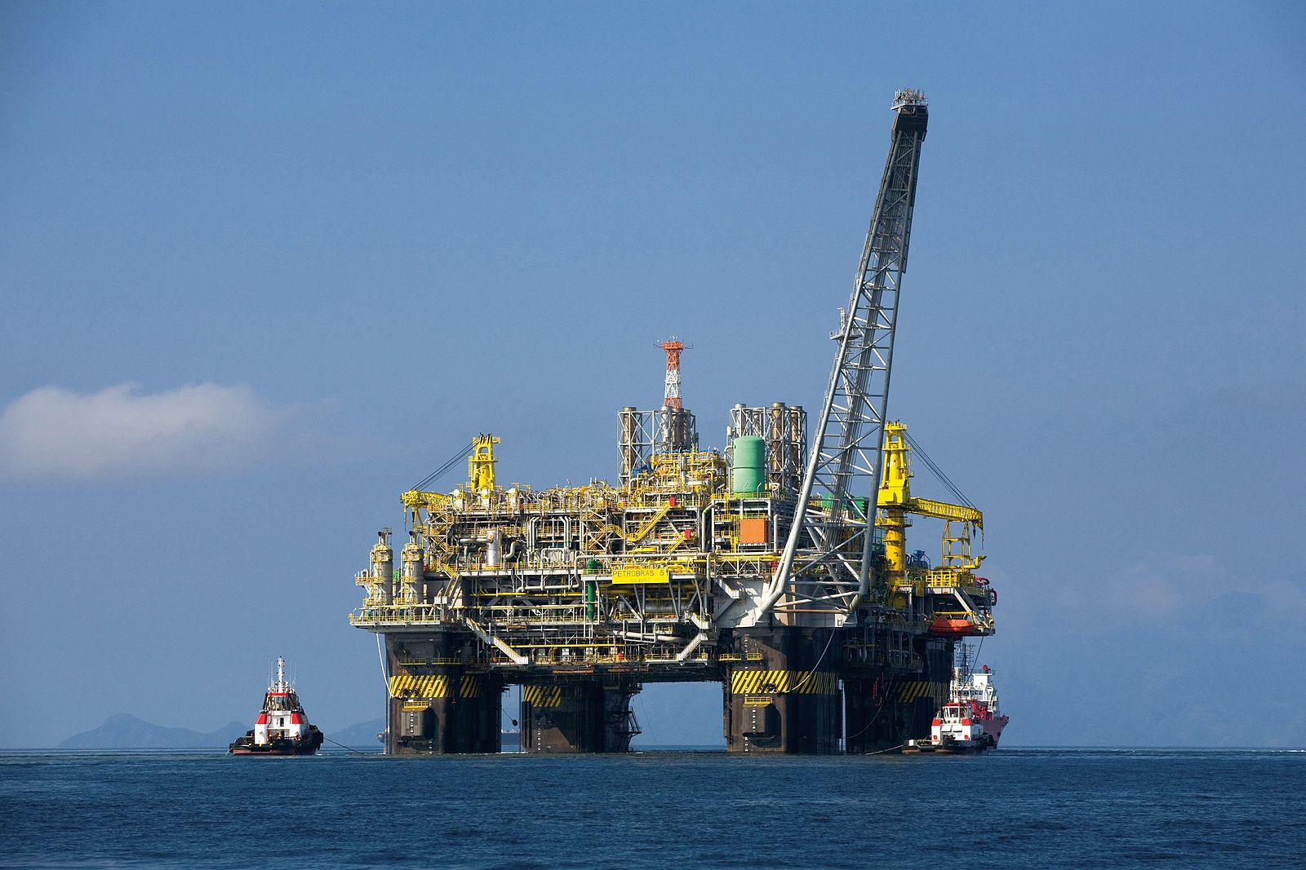
C. Examples
Source: Picture by Ralf Roletschek on commons.Wikimedia.org
Source: Photo by Annie Spratt on Unsplash
Drill for oil
Prospectors, oil platforms, black, dirty, selfish, oil spill
Explore for energy
Nature, explorers, indidana jones, conquest, green and blue, internet explorer

Slide 18
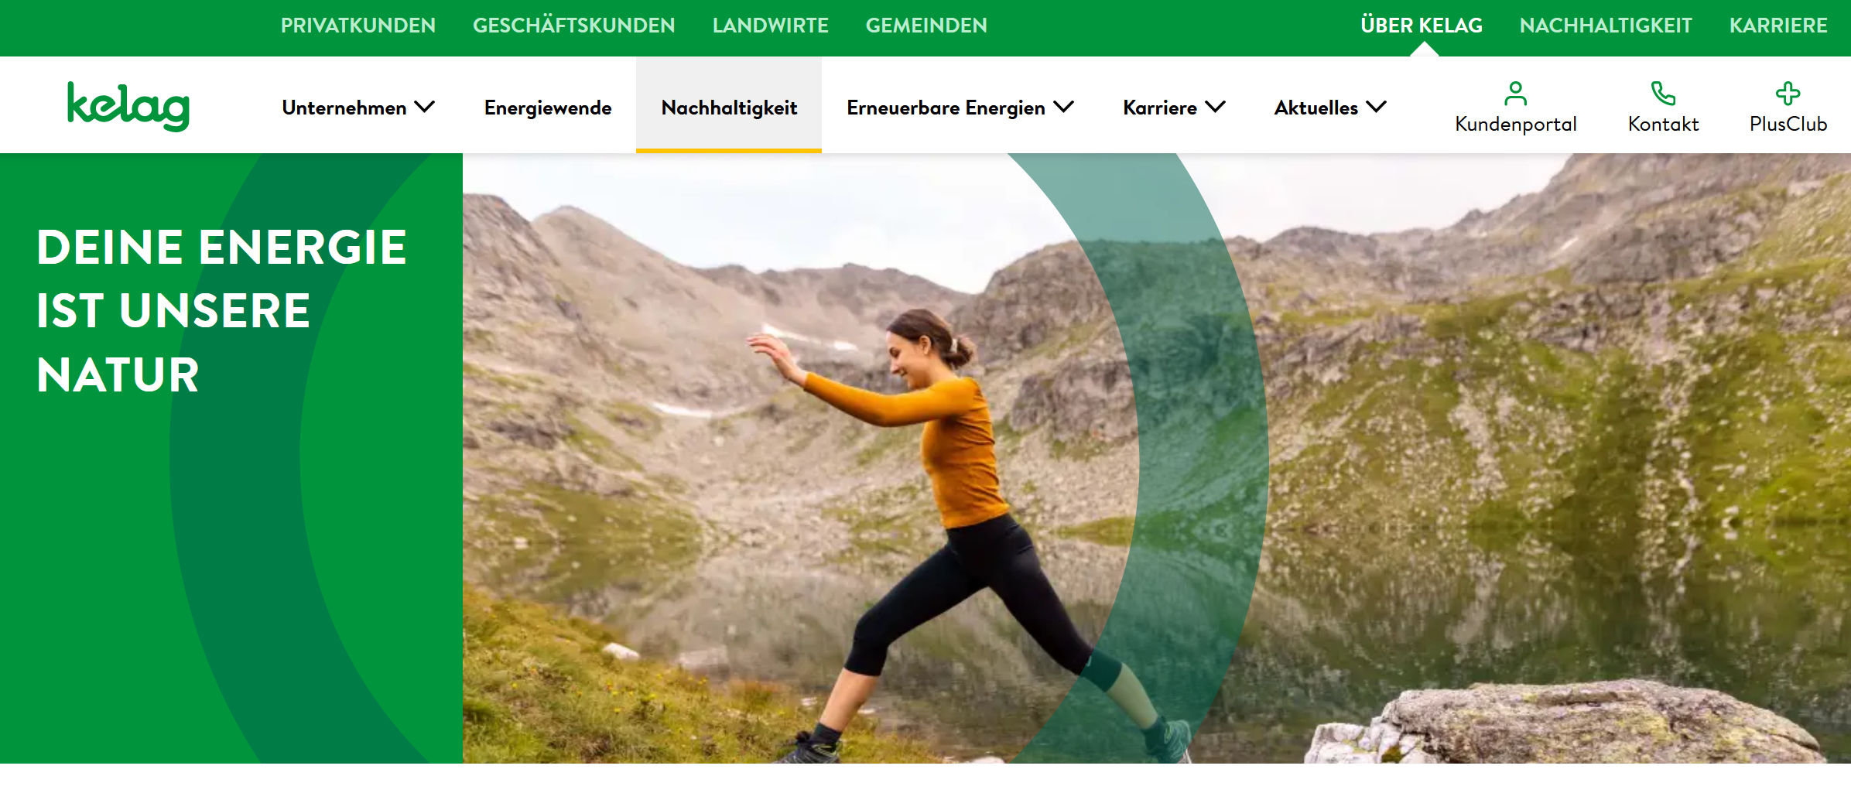
C. Examples
Source: https://www.kelag.at/ueber-kelag/nachhaltigkeit.htm

Slide 19
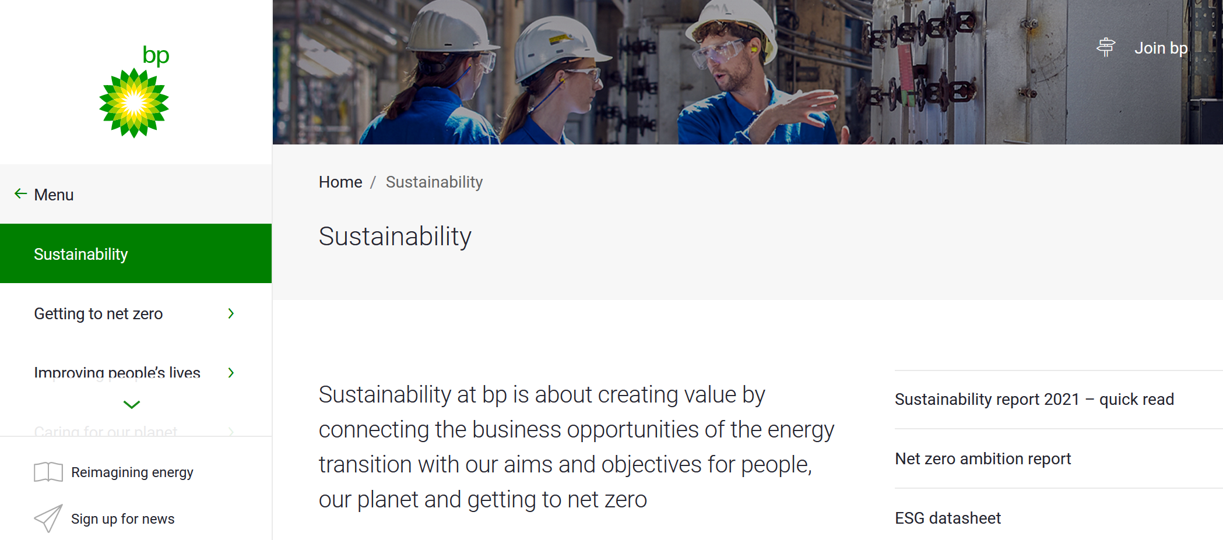
C. Examples
Source: https://www.bp.com/en/global/corporate/sustainability.html
Notes:
Keywords? … und was ist mehr „anfällig“ für greenwashing? MASTERFRAME!

Slide 20
C. Examples
Sustainability?
Definition: the ability of something to be maintained at a certain rate or level].
Masterframe: Avoidance of the depletion of natural resources in order to maintain an ecological balance and sustain our basis of existence
Claim: The committee is developing sustainability standards for products that use energy; with those standard we will help to create a sustainable future.
Alternative (issue specific) frames:
Economic reasonable (reduced costs/economic profitable, ensuring or hindering that the economic system can continue to function in the future)
Optimization (making existing things “better” by making them “sustainable”)
Extra-effort (economic not reasonable, future costs, need more time, not profitable)
Ecological risks (climate catastrophe, risks of nuclear power ..)
Socio-cultural justice (distributional justice, equality, diversity, conditions that allow human beings to meet their needs)
Insecurity (of the future, individual impotence)
Responsibility, consequences of actions (causal relationships)
Regulator frame (regulations needed)
(Over)Moralization (greenwashing, vagueness)
Transformation, Change (society, energy, capitalism – alternatives?)
Notes:
Source of the frames:
Di Giulio : 2003: ecological, environmental, socio-cultural, integrated
Entman & Fischer et al. 2017; Brüggemann Klimawandel
BUT: Are those FRAMES?!?!?!?!?

Slide 21
D. Framing for the future?
Possible categories of analysis:
Connotation/sentiment: positive, negative,
Direction: forward facing, retrospective, justification …
Snow & Benford: Frame Alignment (1988); Weder, 2021
diagnostic framing (identification of a problem and assignment of blame)
prognostic framing (suggestion of solutions, strategies, and tactics to a problem)
motivational framing (serves as a call to arms or rationale for action)
Notes:
They argue that when individual frames become linked in congruency and complementariness, Snow, D. A.; Rochford, E. B.; Worden, S. K.; Benford, R. D. (1986). "Frame alignment processes, micromobilization, and movement participation". American Sociological Review. 51: 464. doi:10.2307/2095581.
Snow and Benford (1988) identify three core framing-tasks, and state that the degree to which framers attend to these tasks will determine participant mobilization.
Note: Snow and Benford (1988) propose that once someone has constructed proper frames as described above, large-scale changes in society such as those necessary for social movement can be achieved through frame-alignment.
Sustainability – as a movement?
Frame-alignment comes in four forms: frame bridging, frame amplification, frame extension and frame transformation.
Frame bridging involves the "linkage of two or more ideologically congruent but structurally unconnected frames regarding a particular issue or problem" (Snow et al., 1986, p. 467). It involves the linkage of a movement to "unmobilized [sic] sentiment pools or public opinion preference clusters" (p. 467) of people who share similar views or grievances but who lack an organizational base.
Frame amplification refers to "the clarification and invigoration of an interpretive frame that bears on a particular issue, problem, or set of events" (Snow et al., 1986, p. 469). This interpretive frame usually involves the invigorating of values or beliefs.
Frame extensions represent a movement's effort to incorporate participants by extending the boundaries of the proposed frame to include or encompass the views, interests, or sentiments of targeted groups (Snow et al., 1986, p. 472).
Frame transformation becomes necessary when the proposed frames "may not resonate with, and on occasion may even appear antithetical to, conventional lifestyles or rituals and extant interpretive frames" (Snow et al., 1986, p. 473).
When this happens, the securing of participants and support requires new values, new meanings and understandings. Goffman (1974, p. 43–44) calls this "keying", where "activities, events, and biographies that are already meaningful from the standpoint of some primary framework, in terms of another framework" (Snow et al., 1986, p. 474) such that they are seen differently. Two types of frame transformation exist:
Domain-specific transformations, such as the attempt to alter the status of groups of people, and
Global interpretive frame-transformation, where the scope of change seems quite radical—as in a change of world-views, total conversions of thought, or uprooting of everything familiar (for example: moving from communism to market capitalism, or vice versa; religious conversion, etc.).

Slide 22
Reflection
Try to define frames and the process of framing in your own words.
What is the difference about a frame and a narrative (more to come in the next episode)?
Try to identify frames in current climate change communication in the media – in newspaper articles, magazines and TV reports. Are there any frames that are used more often than others? Why is that?
What about sustainability – is sustainability a frame itself or are there various “issue specific frames” that are used (and abused) to talk about the future? Are they rather diagnostic, prognostic or even motivational?

