Slide 1
Sustainability Communication as Field of Research
Lesson 01: Literature Review / Status Quo of a Research Area

Slide 2
Where are we?
Episode 1: Literature review, status quo
Episode 2: Methodologies used / studies
Episode 3: Institutionalization of sustainability communication
Episode 4: Future methodologies, engagement

Slide 3
Learning outcomes
Learning outcome 1:
Describe the diverse nature of contemporary practices of sustainability communication on an individual, organizational and societal level, the relationship of strategic communication practices to other public communication practices, the role of stakeholders and publics and the communication practitioners in and outside of organizations (corporate, NGO, political and educational institutions etc.)
Learning outcome 2:
Develop comprehensive and well-founded knowledge in sustainability communication as field of study, an understanding of how other disciplines relate to the field and an international perspective on the field.
Learning outcome 3:
Understand the key elements of communication theories, strategies and tactics, and, thus, the character and operationalization of best practice sustainability communication planning frameworks.
Learning outcome 4:
Advance your understanding of social and civic responsibility and develop an appreciation of the philosophical and social context of sustainability communication. Advance your knowledge and respect of ethics and ethical standards in relation to communication of, about and for sustainability.
Learning outcome 5:
Anticipate and Interpret current issues and challenges of a world in transformation and social change. Develop a deep understanding of and skills to create change, develop advocacy, leadership and authorship in and for sustainability communication.

Slide 4
Recap
Inter- / transdisciplinary approach to SD
Communication
Cultural change
SD agenda
Social change
Problem
Solution
Problem
Solution
Problem
Discipline 1
Discipline 2
Discipline 3
Discipline x

Slide 5
Recap
Science & Risk Communication
Strategic / CSR Communication
Sustainability Communication
Environmental and Social Change Communication
Disciplines
Communication
Discipline 1
Discipline 2
Discipline 3
Discipline x

Slide 6
Recap
Perspectives on Sustainability
Science / CC Communication:
Sustainability as counter narrative (solution?) to climate change
Environmental Communication:
Sustainability as (moral) principle of change
Sustainability as principle of restoration / regeneration
CSR Communication:
Sustainability as principle (moral compass) of action
Sustainability as label for “good behavior”, “used” in communication

Slide 7
Recap
Challenges
Communication about & of environment, risk, CC, CSR
Communication for transformation

Slide 8
What was needed?
Media & communication perspective & theories, concepts, methodologies
Science & Risk Communication
Strategic / CSR Communication
Sustainability Communication
Environmental and Social Change Communication
Notes:
But what is behind this?
has been hampered by the fact that research on SC is organized across several fields of practice (e.g., education, NGO campaigning, corporate communication) and conducted through different academic disciplines (e.g., marketing, media or communication research), which makes it difficult to take stock of the field and systematically develop it further.
What is media / comm studies? What is the background, what do we need to understand to better understand the science of sustainability communication

Slide 9
Paradigms of Sustainability Communication
Paradigms
Pragmatic (communication as structure; information, education, instrumental sense of communication, functionalist/structural perspective, description of reality)
how to communicate sustainability issues to others
Constitutive (communication as process; symbolic action, social constructivism, sense making, define sth as problem, creates attention, evokes values, orientation, activates/stimulates engagement, exploration):
sustainability communication as a process of creation of a mutual understanding of the normative concept of sustainability as well as the individual and societal possibilities of taking action (dialogue & discourse).
Icon made by Raj Dev from www.freeicons.io
Notes:
Did you bring your „glasses“?!? What are the persepctives from which we‘re coming analysing wahts going on out there? ...
When we started on our „trip“ to understanding strategic communication we started with various theoretical approaches ... all exploring and explaining organizational communication and communictaio management with a „paradigm“/basic understanding in the background ...

Slide 10
We found: Sustainability Communication Research …
Functionalist approach to sustainability communication
Concept: Messaging
Constitutive approach to sustainability communication
Concept: Interaction
Objective: Transparency
Metaphor: Conduit
Channels: Monological/one-directional
Perspective: Seqential
Objective: Co-creation
Metapor: Connectedness
Channel: Dialogical
Perspective: Holistic

Slide 11
Where are we now (again ☺) ?
Episode 1: Sustainability Communication as research field: Literature review, status quo
Episode 2: Methodologies used / studies
Episode 3: Institutionalization of sustainability communication
Episode 4: Future methodologies, engagement
Notes:
Is Sustainability communication a research field? And

Slide 12
Learning outcomes
Learning outcome 1:
Describe the diverse nature of contemporary practices of sustainability communication on an individual, organizational and societal level, the relationship of strategic communication practices to other public communication practices, the role of stakeholders and publics and the communication practitioners in and outside of organizations (corporate, NGO, political and educational institutions etc.)
Learning outcome 2:
Develop comprehensive and well-founded knowledge in sustainability communication as field of study, an understanding of how other disciplines relate to the field and an international perspective on the field.
Learning outcome 3:
Understand the key elements of communication theories, strategies and tactics, and, thus, the character and operationalization of best practice sustainability communication planning frameworks.
Learning outcome 4:
Advance your understanding of social and civic responsibility and develop an appreciation of the philosophical and social context of sustainability communication. Advance your knowledge and respect of ethics and ethical standards in relation to communication of, about and for sustainability.
Learning outcome 5:
Anticipate and Interpret current issues and challenges of a world in transformation and social change. Develop a deep understanding of and skills to create change, develop advocacy, leadership and authorship in and for sustainability communication.

Slide 13
Overview
Institutionalization (programs, journals, organizations, chairs)
Methodologies, heuristic
Epistemic "core", paradigms

Slide 14
Overview
Research field or discipline?
Research questions
Existing body of knowledge
Epistemic “core”?

Slide 15
A. Research field or discipline?
What is SC?
Sustainability communication is a business strategy for companies who have integrated sustainability into their operational and strategic activities (Allen, 2006); it‘s about evidence-based strategies for making sustainability vivid, accessible, and comprehensible. (Robertson, 2019)
Sustainability communication is seen as an emerging field that integrates various research approaches and practices. (Godemann and Michelsen, 2011; Cox, 2012; Anderson, 2014; Fischer et al., 2016; Weder et al., 2021a, 2021b).

Slide 16
A. Research field or discipline?
1. Particular object of research or shared object?
Communication about & of Sustainability
Communication for transformation

Slide 17
A. Research field or discipline?
1. Particular object of research or shared object?
2. Body of knowledge referring to the object of research / not shared?
Ecological sustainability, economic opportunity, social inclusion
Discourse about sustainability as communicative process within society (Ziemann, 2011)
Sustainability Communication as global social process – accompanied by the media; SC to advance transformation processes towards more sustainable development (Adomßent & Godemann, 2011)
Notes:
Public sustainability communication: consists of the recursive order of contributions and arguments of the theme of a better ecological economic and social life

Slide 18
B. Research questions asked?
Who communicates about sustainability?
What is communicated about sustainability?
To whom is sustainability communicated?
Which channels are used to communicate (about) sustainability?
What are the effects of sustainability communication?

Slide 19
B. Research questions asked?
Most of the literature approaches communication about sustainability or communication for sustainable development (Newig et al., 2013; Genc, 2017; Weder et al., 2021).
In both dimensions, the functional, instrumental understanding of communication dominates and is increasingly explained and explored (Bjorn et al., 2019; Kuntsman & Rattle, 2019)
with a focus on sustainability reporting, social impact (Daily & Huang, 2001; McKenzie, 2004; chaudhuri & Jayarem, 2018)
on specific media to communicate sustainability (Huang et al., 2019; Maltseva et al., 2019; Fischer et al., 2017),
on dissemination strategies and pedagogical approaches (van Dam-Mieras et al., 2008; Djordjevic & cotton, 2011; Sparin & Timpson, 2012; Genc, 2017)
On participatory processes / skills & capability building in environmental studies/environmental management (van de Fliert, 2021; Reed et al., 2018)
Icon made by Raj Dev from www.freeicons.io

Slide 20
B. Research questions asked?
Furthermore, as already explained, there is a link to the established fields of
corporate social responsibility (CSR) communication (Elving et al., 2015; Diehl et al., 2017; Golob et al., 2017; Rasche et al., 2017; Weder et al., 2019) & corporate sustainability communication (Schlichting, 2013; Lock & Seele, 2015; Signitzer & Prexl, 2007; Weder, 2012)
climate change communication (Stecula & Merkley, 2019; Nerlich et al., 2010; Schäfer, 2012; Forchtner, 2018; Schäfer & Schlichting, 2014; Kannengießer, 2020; see also: I. Neverla; M. Taddicken, M. Brüggemann) and
sustainable consumption communication (Bilharz & Schmitt, 2011; Jackson, 2014; Linea et al., 2016; Fischer et al., 2017).

Slide 21
B. Research questions asked?
Questions:
Dominance of: who communicates about S. to whom through which channel with what effect?
Instead: What is communicated? How is it communicated? What is the nature and potential of a sustainability discourse, what about the cultural dimension?
Sustainability Communication as human and technology based activity of the reciprocal use of signs and the reciprocal interpretation of signs for the purpose of successful understanding, coordinating action and shaping reality
Icon made by Raj Dev from www.freeicons.io

Slide 22
C. Existing body of knowledge
Growing body of knowledge in
Media & communication studies
Science communication (climate change comm., representation of S.)
Public communication (representation of S.)
Strategic communication (CSR comm, reporting, representation of S.)
Economics & marketing (consumer) research / combination with psychology (effects!)
Education / Pedagogy („Bildung für Nachhaltige Entwicklung) (teaching S.)
Culture / art / writing

Slide 23
C. Existing body of knowledge
Cultures of sustainability
We remember: discussions about sustainable development are embedded in patterns of cultural perception and action (justice, equality issues)

Slide 24
C. Existing body of knowledge
Cultures of sustainability
In contrast to a techno-scientific understanding of communication (which has yielded a number of complex transmission models) the social and human science description of communication begins with face-to-face contact (Ziemann, 2011)

Slide 25
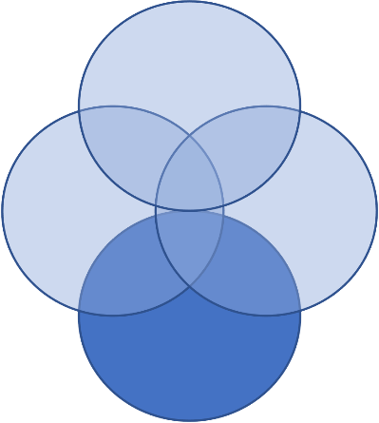
C. Existing body of knowledge
Communication in sustainable development
Communication for sustainable development
Culture of sustainability
culture / communication as 4th dimension of sustainability
(Hammond, 2019; Soini & Dessein, 2016; Soini et al., 2015; Brocchi, 2010; Holrings, 2015; Godemann & Michelsen, 2011; 2013; Weder et al., 2021; Karmasin & Weder, 2008; Weder, 2012; Agyeman, 2007)
Communication as social practice leading to transformation
(Spinozzi & Mazzanti, 2019; Balta Portolés & Roig Madorran, 2013; Weder, 2021; (UN, 2021; Forum d’Avignon, 2014; COST Action IS1007; Weder, 2021)
Sustainability discourse: reflexivity, s. as intrinsic social value, mediatization and normalization
Notes:
Is currently discussed within capitalism – and not as alternative TO capitalism
So if we really want to understand CULTURE AS SD… we need new theories, new methodologies, new pedagogies … and a bit of a revolution!

Slide 26
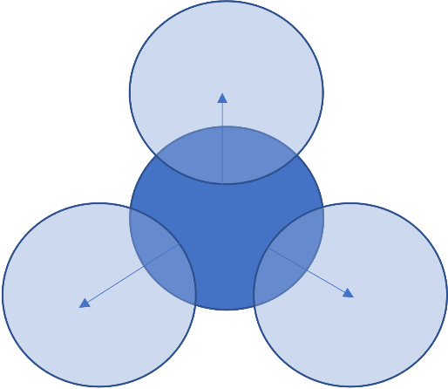
C. Existing body of knowledge
Communication in sustainable development
Communication for sustainable development
Culture of sustainability
culture / communication as 4th dimension of sustainability
(Hammond, 2019; Soini & Dessein, 2016; Soini et al., 2015; Brocchi, 2010; Holrings, 2015; Godemann & Michelsen, 2011; 2013; Weder et al., 2021; Karmasin & Weder, 2008; Weder, 2012; Agyeman, 2007)
Communication as social practice leading to transformation
(Spinozzi & Mazzanti, 2019; Balta Portolés & Roig Madorran, 2013; Weder, 2021; (UN, 2021; Forum d’Avignon, 2014; COST Action IS1007; Weder, 2021)
Sustainability discourse: reflexivity, s. as intrinsic social value, mediatization and normalization
Notes:
Is currently discussed within capitalism – and not as alternative TO capitalism
So if we really want to understand CULTURE AS SD… we need new theories, new methodologies, new pedagogies … and a bit of a revolution!

Slide 27
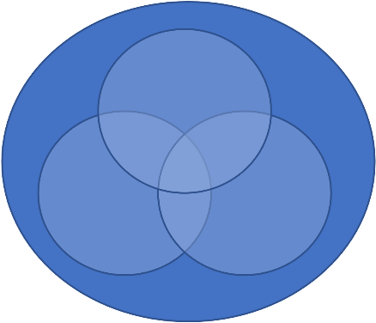
C. Existing body of knowledge
Communication in sustainable development
Communication for sustainable development
Culture of sustainability
culture / communication as 4th dimension of sustainability
(Hammond, 2019; Soini & Dessein, 2016; Soini et al., 2015; Brocchi, 2010; Holrings, 2015; Godemann & Michelsen, 2011; 2013; Weder et al., 2021; Karmasin & Weder, 2008; Weder, 2012; Agyeman, 2007)
Communication as social practice leading to transformation
(Spinozzi & Mazzanti, 2019; Balta Portolés & Roig Madorran, 2013; Weder, 2021; (UN, 2021; Forum d’Avignon, 2014; COST Action IS1007; Weder, 2021)
Sustainability discourse: reflexivity, s. as intrinsic social value, mediatization and normalization
Notes:
Is currently discussed within capitalism – and not as alternative TO capitalism
So if we really want to understand CULTURE AS SD… we need new theories, new methodologies, new pedagogies … and a bit of a revolution!

Slide 28
D. Epistemic “core”?
Does „Sustainability Communication“ have an epistemic core?
Popularization concepts (concepts, plans be made known to the general public, offer concrete orientation for action)
Innovation & alliance concepts (social, technological innovations should be initiated; variety of social actors should work together; strategic networks)
Information & education concepts (content and aspects of SD need to be implemented in the education system; learn about S & develop reflexive competences)
BUT: Research concepts – not yet developed: interdisciplinary scientific discourse, development of own perspectives and applications needed – especially for economic and political actors

Slide 29
D. Epistemic “core”?
Does „Sustainability Communication“ have an epistemic core?
SC: as process of mutual understanding dealing with the future development of society at the core of which is a vision of sustainability (Godemann / Michelsen, 2011)
Mutual understanding on:
An individual level
An organizational level
A societal level and:
... between individuals and institutions, between institutions and within institutions, in schools & Universities, in the media, in politics, in communities and at a regional, national and international level

Slide 30
D. Epistemic “core”?
Does „Sustainability Communication“ have an epistemic core?
...not yet ..
Sustainability studies and other scientific engagement with the notion of sustainable development has an interdisciplinary, as well as transdisciplinary character (Weder et al., 2019).
common ground of understanding sustainability communication as introducing an understanding of the world, that is of the relationship between humans and their environment, into social discourse (Godemann & Michelsen, 2011).

Slide 31
D. Epistemic “core”?
Does „Sustainability Communication“ have an epistemic core?
...not yet ..
...a critical, constructivist, cultural perspective need to be strengthened
acknowledges not only consensus as primary goal of or condition for communication, but dissensus is particularly important for the continuation of communication (every communication invites protest)
offers a way to explain the difficulty in communicating new ideas and knowledge to others
learning as intentional, self-controlled process & social learning
handling complexity
new knowledge and new experiences have to „fit“ so that they are compatible with previous experiences and insights
risk needs to be taken into consideration
lifestyle vs. way of life
public discourses & normalization of „new“ values

Slide 32
Reflection
How would you describe the status quo of research in the area of sustainability communication?
Which are the disciplines that deal with sustainability communication so far?
Which perspective on and understanding of communication is dominant in the research so far?
Why does it make sense to bring in a cultural, critical and rather social-constructivist perspective in communication?

