Slide 1
Theories & Perspectives
Lesson 02: Communication on an individual Level

Slide 2
Where are we?
Episode 1: Social & Cultural Sciences & Paradigms
Episode 2: Communication on an individual level
Episode 3: Communication on an organizational level
Episode 4: Communiation on a social level, communication as culture

Slide 3
Learning outcomes
Learning outcome 1:
Describe the diverse nature of contemporary practices of sustainability communication on an individual, organizational and societal level, the relationship of strategic communication practices to other public communication practices, the role of stakeholders and publics and the communication practitioners in and outside of organizations (corporate, NGO, political and educational institutions etc.)
Learning outcome 2:
Develop comprehensive and well-founded knowledge in sustainability communication as field of study, an understanding of how other disciplines relate to the field and an international perspective on the field.
Learning outcome 3:
Understand the key elements of communication theories, strategies and tactics, and, thus, the character and operationalization of best practice sustainability communication planning frameworks.
Learning outcome 4:
Advance your understanding of social and civic responsibility and develop an appreciation of the philosophical and social context of sustainability communication. Advance your knowledge and respect of ethics and ethical standards in relation to communication of, about and for sustainability.
Learning outcome 5:
Anticipate and Interpret current issues and challenges of a world in transformation and social change. Develop a deep understanding of and skills to create change, develop advocacy, leadership and authorship in and for sustainability communication.

Slide 4
Recap
Paradigms
Pragmatic (communication as structure; information, education, instrumental sense of communication, functionalist/structural perspective, description of reality)
Constitutive (communication as process; symbolic action, social constructivism, sense making, define sth as problem, creates attention, evokes values, orientation, activates/stimulates engagement, exploration)
Icon made by Raj Dev from www.freeicons.io
Notes:
Did you bring your „glasses“?!? What are the persepctives from which we‘re coming analysing wahts going on out there? ...
When we started on our „trip“ to understanding strategic communication we started with various theoretical approaches ... all exploring and explaining organizational communication and communictaio management with a „paradigm“/basic understanding in the background ...

Slide 5
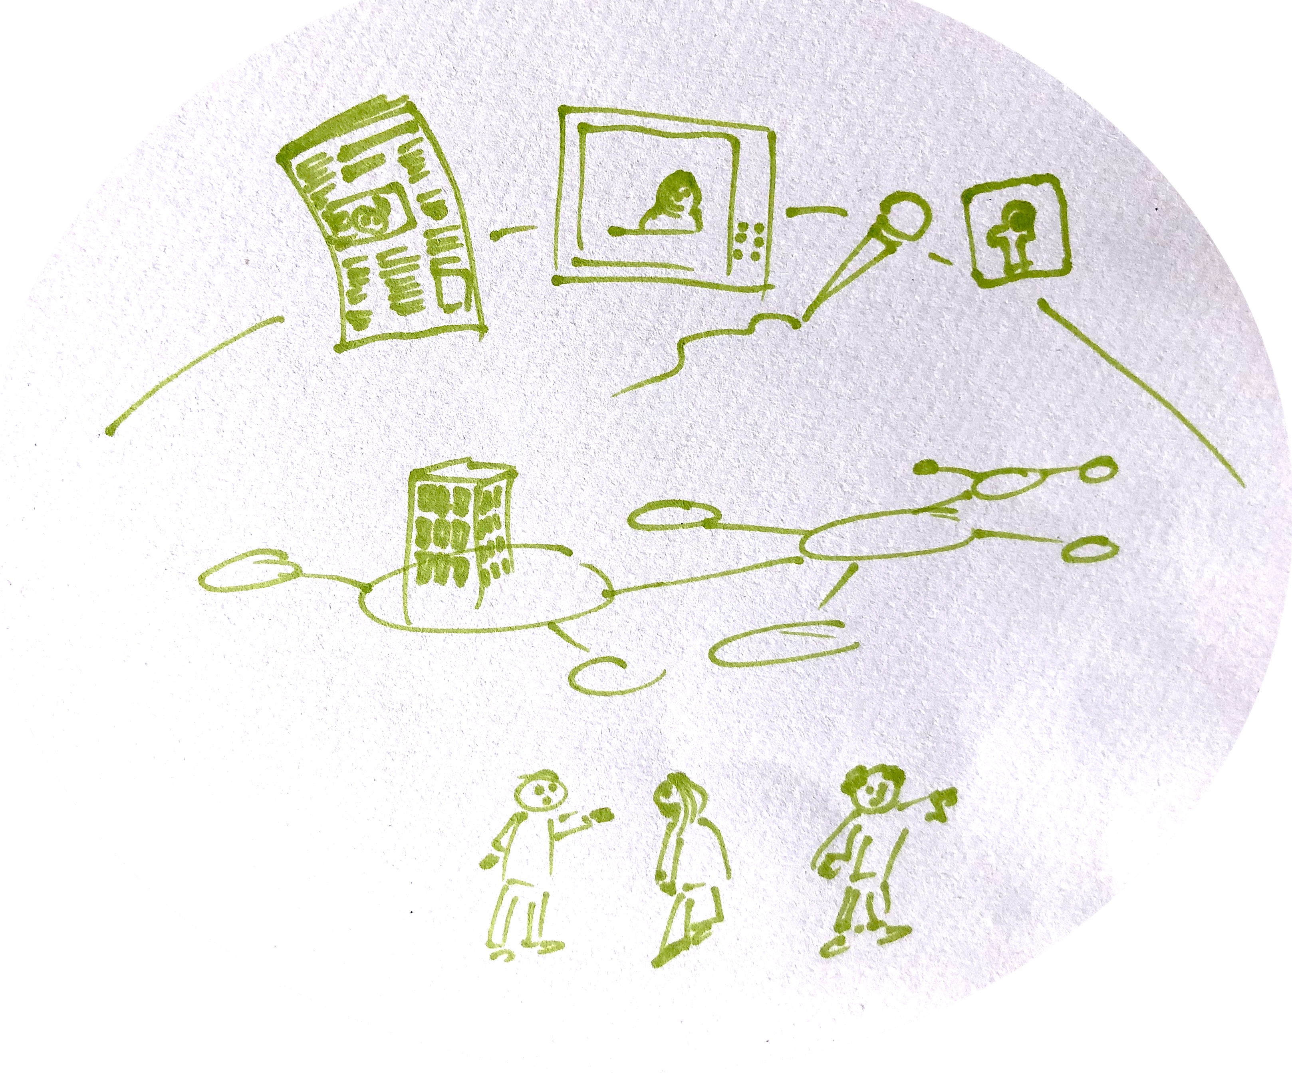
Recap
_MACRO: social system, cultural context, public discourses/public sphere
Communication
_MESO: organizations, institutions, stakeholder/audiences
_MICRO: intra-/interpersonal communication
Notes:
Communication as structure & process
We can look at communication as structure and process on three different levels!…

Slide 6
Overview
Interpersonal communication
Communicators
Notes:
Science Theory
Why do we need „theories“?
What are the main paradigms we need to understand Sustainability Communication phenomena?

Slide 7
A. Interpersonal communication
Interpersonal communication is
an interaction between two or more people
a process of...
understanding
exchange
participation
relationship
social practice
social behavior
interaction

Slide 8
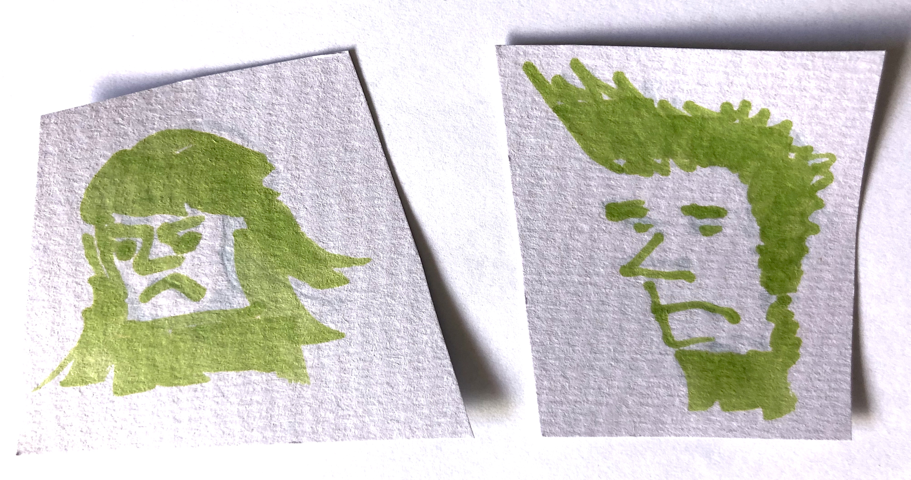
A. Interpersonal communication
_verbal & nonverbal

Slide 9
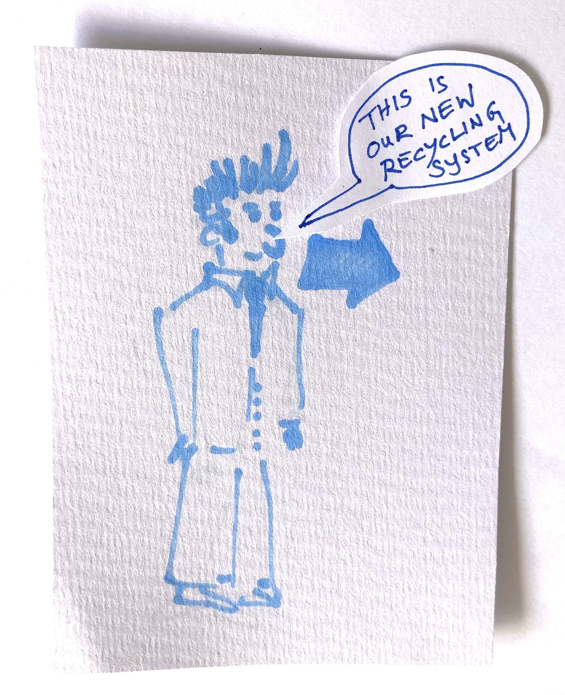
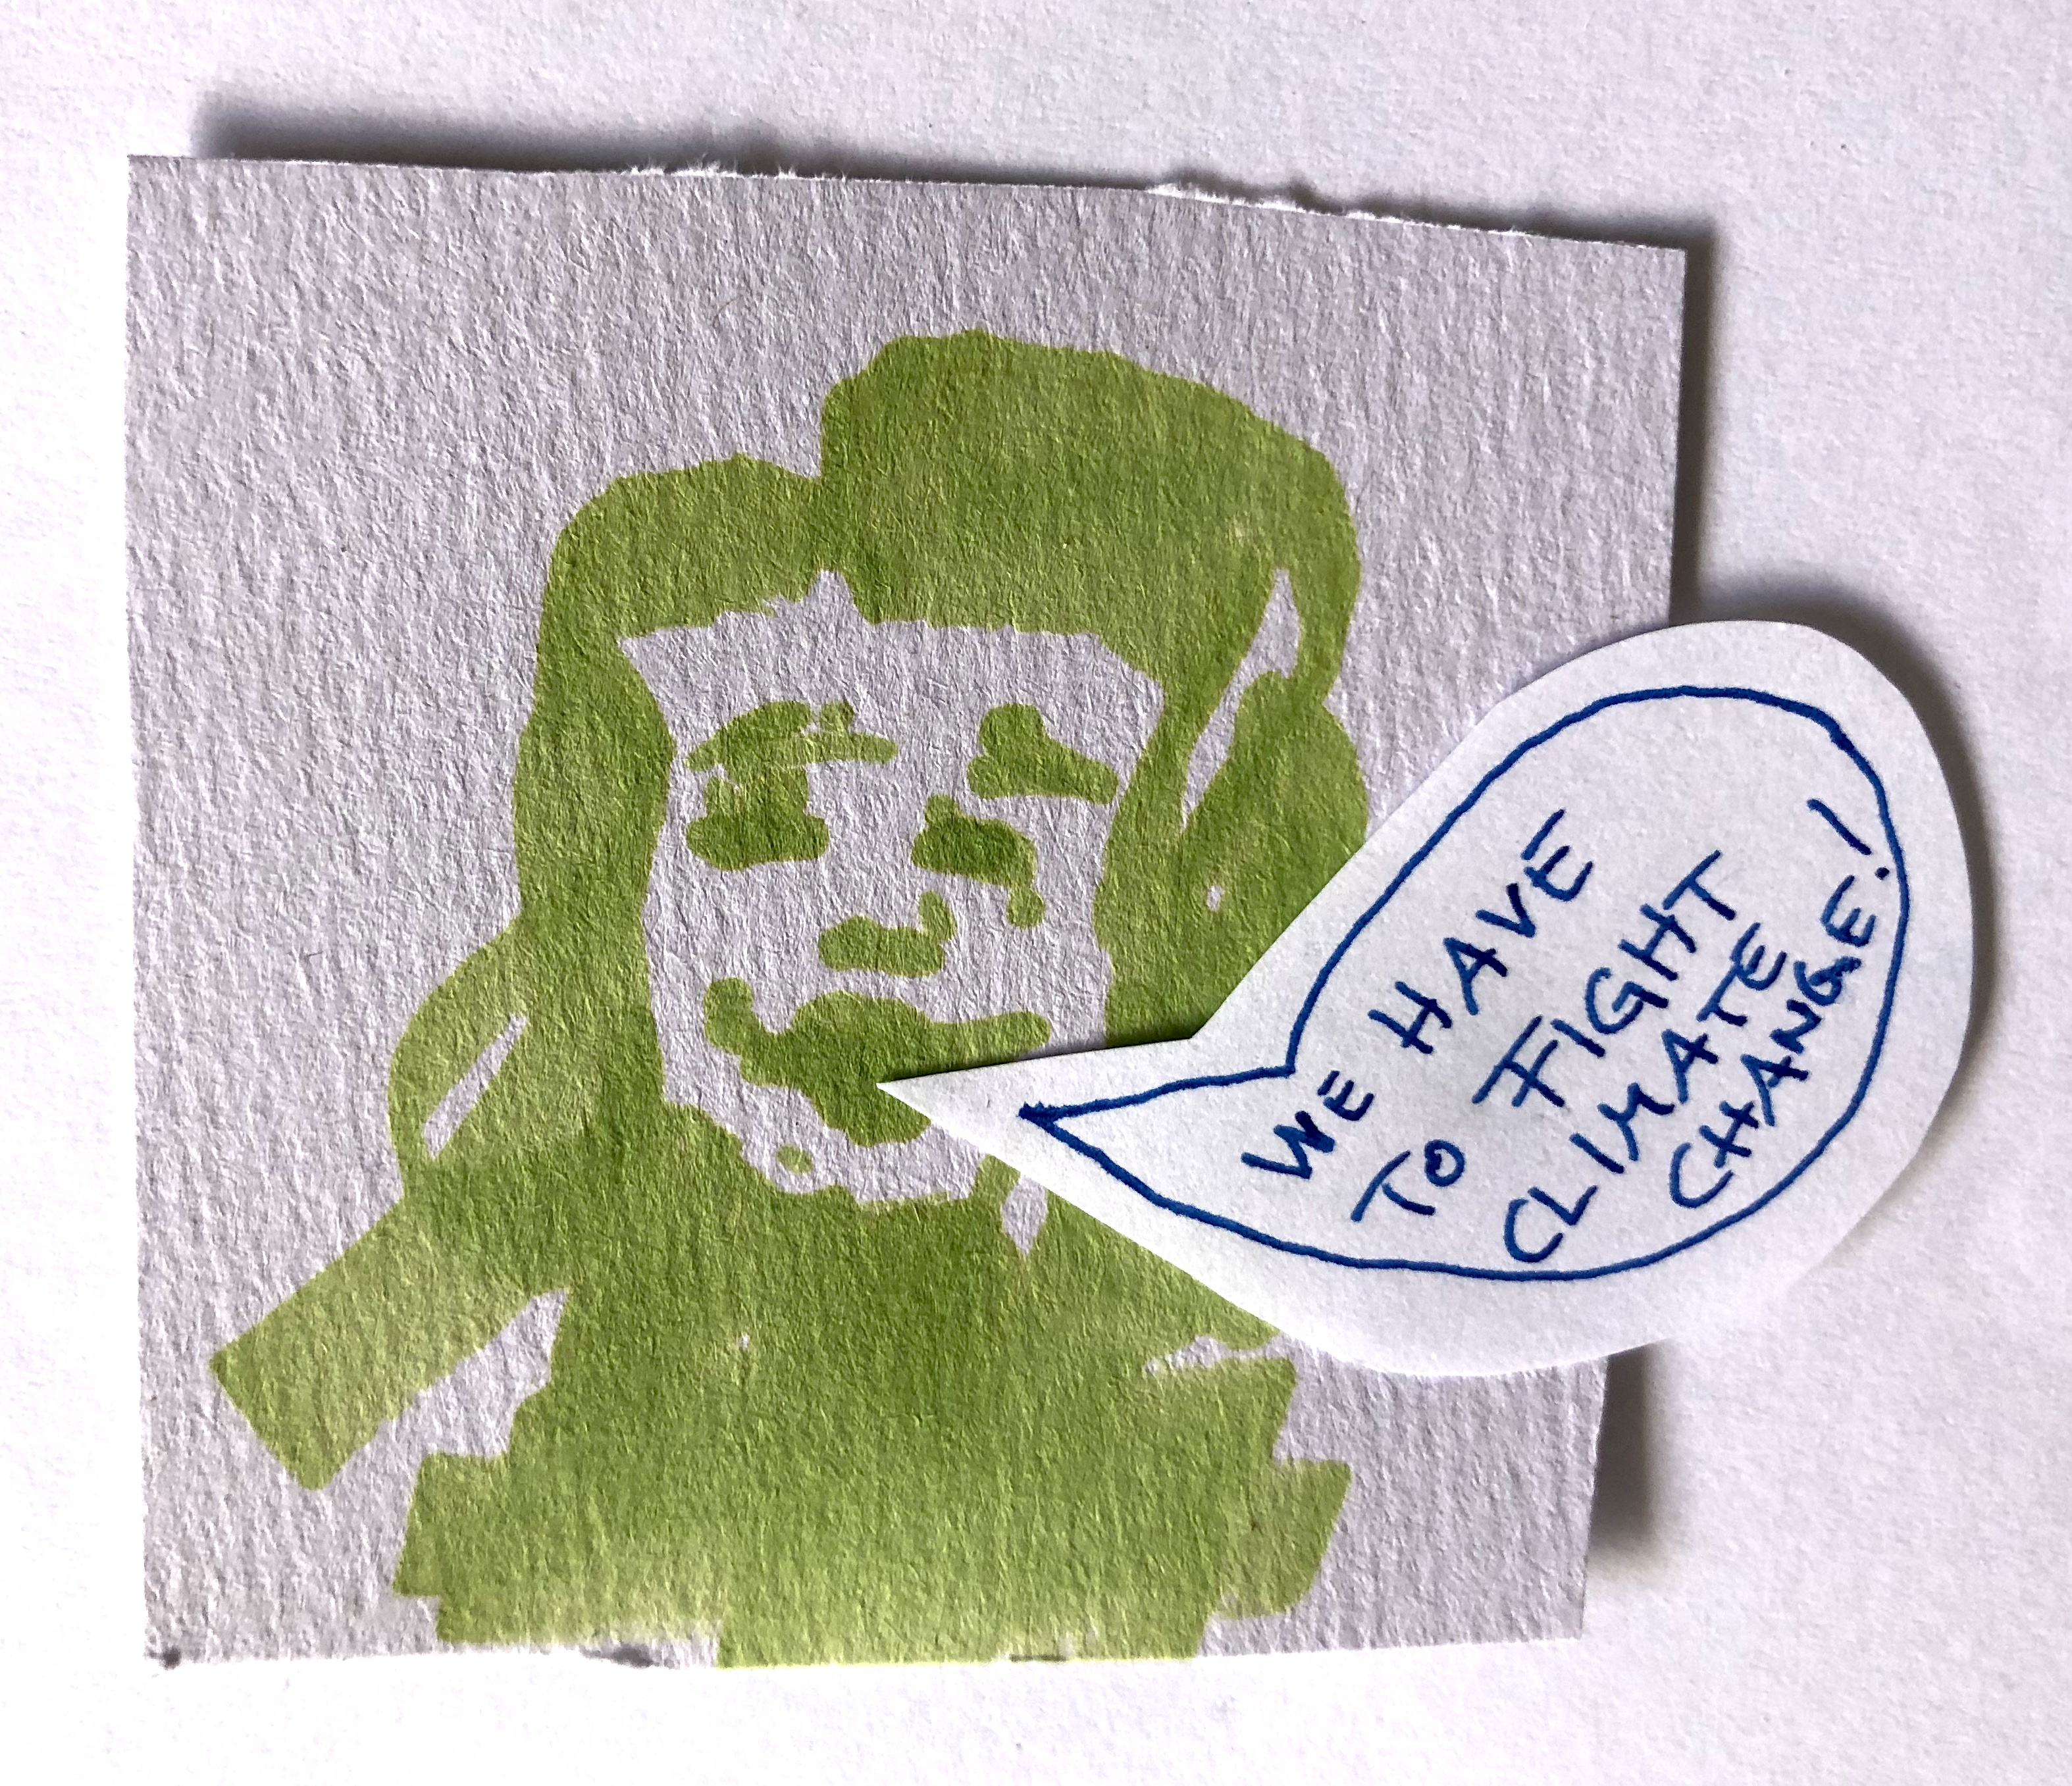
A. Interpersonal communication
_formal & informal

Slide 10
A. Interpersonal communication
Questions:
how humans adjust and adapt their verbal / nonverbal communication in face-to-face interactions
How are messages produced and transmitted
How does uncertainty influence behaviour and information-management strategies
How is communication changed, distorted, varied
Relationships and dialogues and
mediated social interactions

Slide 11
A. Interpersonal communication
objective interpretive
pragmatic
constitutive
Icon made by Raj Dev from www.freeicons.io
Notes:
Bringing in the two perspectives on communication….

Slide 12
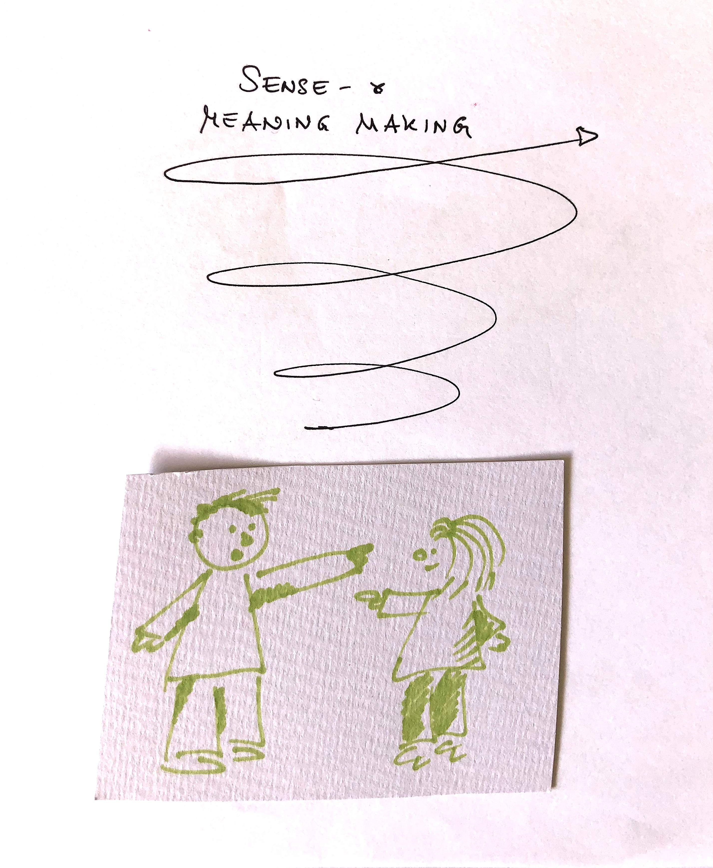
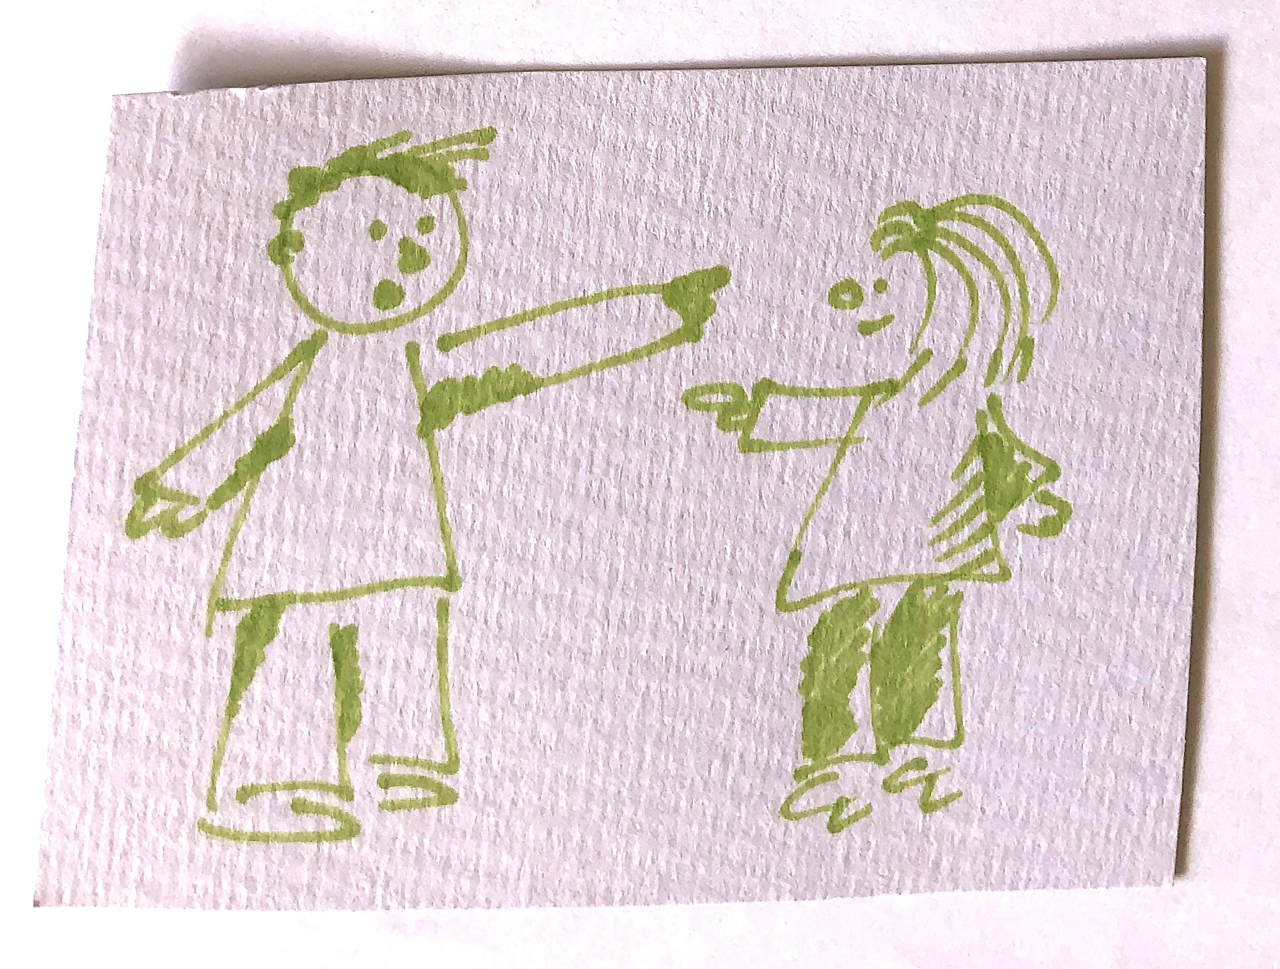
A. Interpersonal communication
_"the ongoing retrospective development of plausible images that rationalize what people are doing" (Weick, Sutcliffe, & Obstfeld, 2005, p. 409).
Icon made by Raj Dev from www.freeicons.io
Notes:
Exchange of information, knowledge …
Or: sense - & meaning making
Sensemaking or sense-making is the process by which people give meaning to their collective experiences. ... It has been defined as "the ongoing retrospective development of plausible images that rationalize what people are doing" (Weick, Sutcliffe, & Obstfeld, 2005, p. 409).

Slide 13
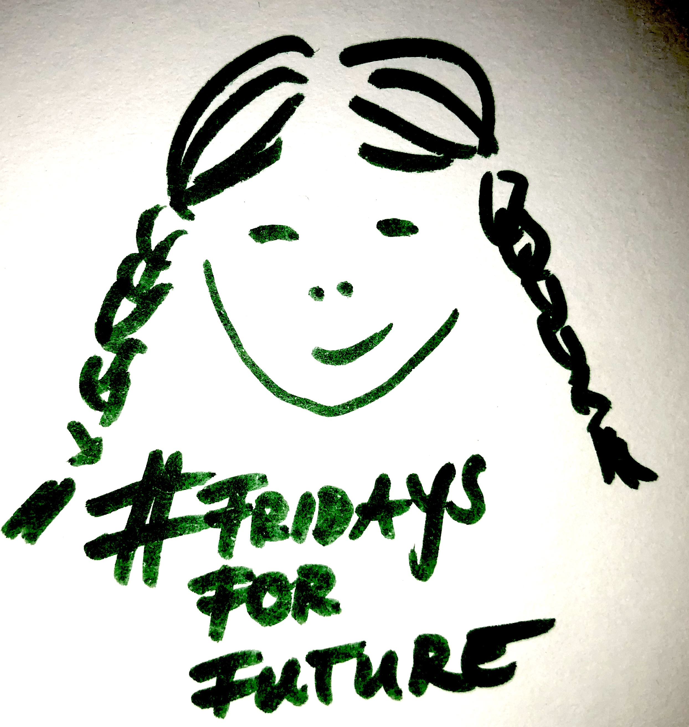
A. Interpersonal communication
Icon made by Raj Dev from www.freeicons.io
Notes:
Sustainability communication as information … or: stimulation, engagement, starting point of new ideas …

Slide 14
B. Communicator
... a person who communicates, especially one skilled at conveying information, ideas, or policy to the public.
In other words:
Speaker
Public speaker
Conversationist
Professional communicators
make information available as well as evidence to inform the public about issues that matter to them - in the most neutral way possible
Source: https://bigthink.com/think-tank/the-cheerleader-effect-why-youre-more-attractive-in-a-group, 08/2018

Slide 15
B. Communicator
Wide range of „roles“ in communication practice: creative artists, writers, editors, journalists, bloggers, influencers, activists, educators, social advocates, politicians, businessmen and businesswomen, preachers, scientists, journalists, PR & marketing professionals, consultants
Common ground of „professional communicators“: desire and drive to send and receive messages and make an impact on a certain audience; to serve the general public and the public of their choices
Operate with a wide variety of mediums and media and communication techniques & tools
Competences: along their delivery of roles and functions; listening, reading, writing, and speaking skills
Source: https://bigthink.com/think-tank/the-cheerleader-effect-why-youre-more-attractive-in-a-group, 08/2018

Slide 16
B. Communicator
„The Journalist“
Information function
Social functions: orientation, socialization, integration
Economic function: circulation, regeneration, issue management
Political functions: creation of the public sphere, articulation, education, critique, control
Source: https://bigthink.com/think-tank/the-cheerleader-effect-why-youre-more-attractive-in-a-group, 08/2018
Notes:
Changes in journalism, - functions („original normative framwork)
the grand challenges:
Out there, there are more arguments & perspectives, new forms of polarization & new contexts and contextual clues (thinking of PR influence etc.)
Watchdog? Or cheerleader? Thinking of new forms of journalism like crowdfunded journalism, donation-funded journalism, science media centers/independent press offices, bloggers/influencers, trolls

Slide 17
B. Communicator
„The Marketing professional“
Market segmentation & evaluation; market research
Marketing goals
Planning of new products/services; innovation management
Planning, strategies of marketing
Composing the marketing mix
Customer relationship, sales & distribution structures
Controlling, evaluation
https://www.maxsalerno.com/news/der-grösste-vorteil-eines-marketers-mensch-zu-sein/
Notes:
Marketing?!? The other side of the desk....
evaluation - planning - realization - evaluation
"MANAGEMENT", strategic, sees communication as INSTRUMENT!!! thinks baout channels etc.

Slide 18
B. Communicator
„The PR professional“
Information
Contact, networking
Image building
Harmonization, balance
Stabilization
Coherence, continuity
Social function

Slide 19
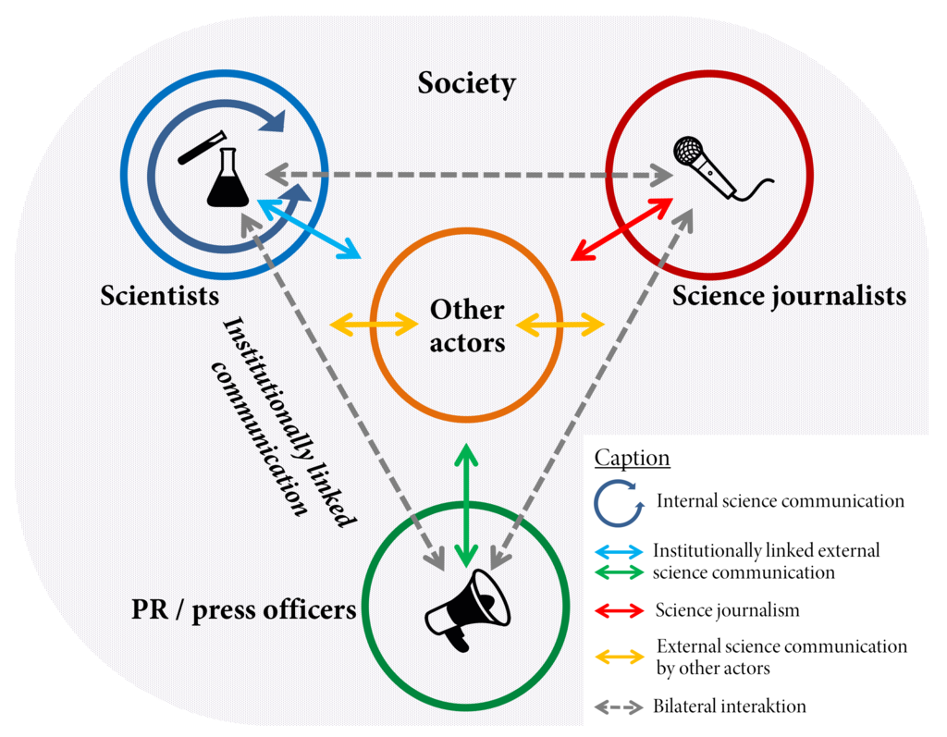
B. Communicator
Schematic Overview of the field and the actors of science communication according to Carsten Könneker
Source: Graphik by Spektrumdw on Wikimedia, Licence: CC-By-SA 4.0

Slide 20
B. Communicator
„The Scientist/science communicator“
Information
Education
Raising awareness of science-related topics,
Increasing the sense of „wonder“ about scientific discoveries and arguments
Advising policy makers about scientific issues,
Building/creating scientific exhibits and curating of exhibitions

Slide 21
B. Communicator
„The Environmentalist/campaigner“
Information
Research
Education
Lobbying
Advising policy makers
Fundraising
Campaigning

Slide 22
B. Communicator
“Participatory” communicator roles
Citizen journalists
Blogger (Vlogger, Instagramer etc.)
Influencer
Notes:
“participatory” communicator roles (citizen journalists, blogger etc., Wall, 2017) challenge our established principles and practices of journalism (Neuberger, 2014; Lee-Wright et al., 2012; Harcup, 2004; Pavlik, 2011).

Slide 23
B. Communicator
And what about you?
Source: https://www.datenschutz-notizen.de/sound-an-handy-aus-4315244/,
Notes:
Digitalization, convergence and concentration – lead to a new media logic, new logic of production, produsage ...
Buzzwords – and related phenomena - like „big data“, „artificial intelligence“ and questions of regulation & ethics ->
challenge communication practitioners – as well as us, media, language, communication and journalism researchers and social sciences in general...
These devlopments rock our field!

Slide 24
B. Communicator
Challenge: New communicators
Social media influencers (vloggers, bloggers, instagramers, youtubers), not only promoting products & brands, also communicate their political opinions to a large network of followers (Allgaier, 2020; Zimmermann et al., 2020)
Availability of social networking sites makes it easier to voice opinions outside the political establishment
New: „Digital opinion leaders“ (Schmuck, 2021), powerful impact on attitudes & behavior of followers

Slide 25
B. Communicator
Communicator - What does it mean today?
Related to the role (salary, degree of institutionalization)
Individual perspective
Structural perspective
Formal perspective
Web-logs/Blogger
Citizenjournalism
Writer
Web-Publishing
User-generated content
Journalism
Web-Media(-production)
Corporate Publishing
PR
Marketing

Slide 26
B. Communicator
Communicator - What does it mean?
Related to the role (salary, degree of institutionalization)
Related to the understanding of the role (ethics)...
Notes:
Fragen überlegen...

Slide 27
B. Communicator
Sustainability Communicator
Sustainability Communication as “ethical duty” (Cox, 2008)
“knowledge & learning is not utterly dominated by abstract theoretical notions but where it is material, interconnecting, affecting & urgent”
Sustainability Communication as “field” das “challenges conventional academic & cultural norms”
We are ACTORS & POTENTIAL CHANGE AGENTS (empowering agents of change, Hooks, 1994; O’Sullivan, 2002; Kahn, 2008; Milstein, 2012)
Notes:
Fragen überlegen...

Slide 28
Outlook
Challenges in Sustainability Communication from a communicator perspective
Mediatization, Digitalization
Role shifts & conflicts: Freelance journalists working in public relations
Professionalized communicators needed (with journalism skills, training and backgrounds)
Changes in the media industries - networked society, shifting dynamics, new forms of content production and distribution, new economic models
Ethics / idealism
Communication for sustainability & transformation: Individual vs. Organizations
Notes:
A shift in news production and dissemination has occurred with power moving away from journalism to public relations (Davies, 2009).
The lit. we analysed focusses on …

Slide 29
Reflection
Think about professional communicators
Who are new communicator roles?
How easy / hard is it to communicate about climate change?
How easy / hard is it to communicate about sustainability?
Think about you, yourself: where do you communicate? What do you communicate about? And what happens with your communication / messages?

