Slide 1
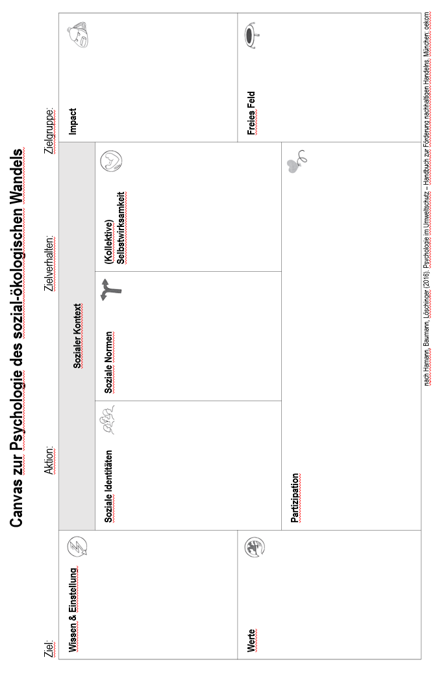
Arbeitsblatt zu Episode 9.3

Slide 2
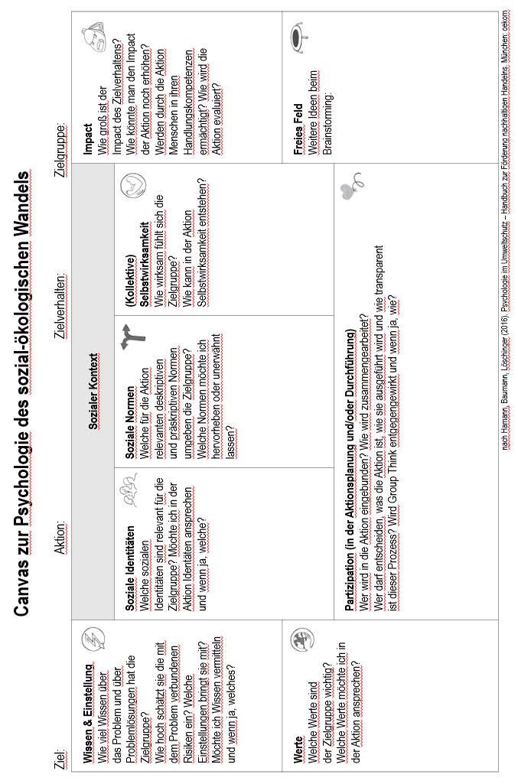
Arbeitsblatt zu Episode 9.3

